Slide 1
INNOVATIVE UNIVERSITIES
The World’s Universities with Real Impact (WURI) Ranking 2022
Thriving in the New Normal
Hwy-chang Moon Professor Emeritus, Seoul National University
Founding Director, The WURI Ranking

Slide 2
Table of Contents
The New Ranking: Importance and Methodology
The Rankings of Innovative Universities
Cases and Implications
Conclusion

Slide 3
Table of Contents
☞
The New Ranking: Importance and Methodology
The Rankings of Innovative Universities
Cases and Implications
Conclusion

Slide 4
The New Normal
The emergence of COVID-19
Severe enrollment decline
Particularly the low- and moderate-income students in the public universities
The spread of industrial revolution
Accelerated implementation of high technologies
Artificial Intelligence, Big Data, Cloud Services, and Digital Technology
There is a doubt about the value of traditional higher education.
Universities need a different approach.

Slide 5
Challenges by the Companies in the Real World
Big Tech Companies are looking for new ways to hire people without college degrees.
Companies like Google and Apple do not require a college degree for certain positions.
Google recently launched a new selection of courses under its Google Career Certificates program, which only take about six months to complete.
Their job postings typically list ‘bachelor’s degree’ first as a qualification, sometimes followed by ‘or equivalent practical experience’.

Slide 6
Problems with Existing Models for University Evaluation
Existing Models
THE World University Rankings (Times Higher Education, UK)
QS World University Rankings (Quacquarelli Symonds, UK)
Academic Ranking of World Universities (ARWU, Shanghai Ranking Consultancy, China)
US News Best Global Universities Rankings (US News, USA)
World’s Most Innovative Universities (Reuters, UK)
Common Problems
Academic Tradition vs. Real Impacts on the World

Slide 7
A New Approach: Real Impacts on the World
Industrial applications
rather than the traditional ways of counting research papers and lecture-type teaching.
Entrepreneurial spirit and value-creating startups
rather than a focus on the number of jobs filled.
Ethical value and social responsibility
rather than a focus on knowledge and skills just for material success.
Student mobility and openness
⬄ rather than an independent yet closed system.
Crisis management
to thrive rather than just to survive.
Progress in the era of Fourth Industrial Revolution
Artificial Intelligence, Big Data, Cloud Services, and Digital Technology.

Slide 8
The Criteria for Evaluation
 | Innovativeness | Implementability | Impact
(1) Industrial Application
(2) Entrepreneurial Spirit
(3) Ethical Value
(4) Student Mobility & Openness
(5) Crisis Management
(6) Fourth Industrial Revolution
Content
Process
Cost
Benefit
Scope
Intensity

Slide 9
The Process of Evaluation
Phase 1: Evaluation
Date: By May 2, 2022
Presidents or the school’s evaluation team designated by the president
Phase 2: Judgment
Date: By May 23, 2022
Representatives of the university leagues and the members of the WURI Evaluation Board
Phase 3: Final Review
Date: By June 3, 2022
WURI Evaluation Board checked the reliability of the contents in the submitted applications, aggregated the recommendations of the judges, and finalized the entries of the WURI Ranking 2022

Slide 10
Table of Contents
The New Ranking: Importance and Methodology
☞
The Rankings of Innovative Universities
Cases and Implications
Conclusion

Slide 11
The WURI Ranking 2022
To be presented at the online conference
Top 50 in each of the six categories
Global Top 100
To be uploaded on the WURI website (www.wuri.world)
Top 50 in each of the six categories
Global Top 100
Global Top 101 - 200, 201 - 300
Presentation slides
Other information
Questions and comments (top100@wuri.world, www.wuri.world)
11

Slide 12
Top 50 Six Categories
12

Slide 13
WURI 2022: Top 50 (Industrial Application)
Rank | Name | Region | Rank | Name | Region
1 | Minerva University | USA | 26 | Northwestern University | USA
2 | Massachusetts Institute of Technology (MIT) | USA | 27 | Griffith University | Australia
3 | Arizona State University | USA | 28 | Chungwoon University | Korea, Rep.
4 | California Institute of Technology | USA | 29 | University of Amikom Yogyakarta | Indonesia
5 | Stanford University | USA | 30 | Charles Darwin University | Australia
6 | Incheon National University | Korea, Rep. | 31 | Hanbat National University | Korea, Rep.
7 | Olin College of Engineering | USA | 32 | Kunjang University College | Korea, Rep.
8 | University of California, Merced | USA | 33 | Deggendorf Institute of Technology (DIT) | Germany
9 | University of Oxford | United Kingdom | 34 | Seoul School of Integrated Sciences and Technologies | Korea, Rep.
10 | Tsinghua University | China | 35 | Cebu Technological University | Philippines
11 | University of Cambridge | United Kingdom | 36 | Mariano Marcos State University | Philippines
12 | Cheung Kong Graduate School of Business (CKGSB) | China | 37 | National University of Management (NUM) | Cambodia
13 | Burapha University | Thailand | 38 | Hong Kong University of Science and Technology | Hong Kong SAR
14 | Kyoto University | Japan | 39 | Fatima Jinnah Women University | Pakistan
15 | Singularity University | USA | 40 | National Chi Nan University | Taiwan, China
16 | University of Technology Sydney | Australia | 41 | ICFAI University | India
17 | Franklin University Switzerland | Switzerland | 42 | University of Pretoria | South Africa
18 | Belgorod State National Research University | Russia | 43 | Samar State University (SSU) | Philippines
19 | University of Gothenburg | Sweden | 44 | University of Antwerp | Belgium
20 | Ohio State University | USA | 45 | Brighton and Sussex Medical School | United Kingdom
21 | Hankuk University of Foreign Studies | Korea, Rep. | 46 | Lac Hong University (LHU) | Vietnam
22 | Tampere University | Finland | 47 | World University of Bangladesh (WUB) | Bangladesh
23 | Sakarya University | Türkiye | 48 | Telkom University | Indonesia
24 | Simon Fraser University | Canada | 49 | University of Liberal Arts Bangladesh (ULAB) | Bangladesh
25 | Seoul Institute of the Arts | Korea, Rep. | 50 | Abdullah Gul University | Türkiye

Slide 14
WURI 2022: Top 50 (Entrepreneurial Spirit)
Rank | Name | Region | Rank | Name | Region
1 | Simon Fraser University (SFU) | Canada | 26 | Draper University | USA
2 | Deggendorf Institute of Technology (DIT) | Germany | 27 | National University of Management (NUM) | Cambodia
3 | Hanze University of Applied Sciences | Netherlands | 28 | University of Évora | Portugal
4 | Aalto University | Finland | 29 | Bucharest University of Economic Studies (BUES) | Romania
5 | University of California, Berkeley | USA | 30 | FEU Institute of Technology (FEU Tech) | Philippines
6 | Princeton University | USA | 31 | Ajou University | Korea, Rep.
7 | Polytechnic Institute of Bragança | Portugal | 32 | University of Wollongong | USA
8 | University of Tokyo | Japan | 33 | Samsung Art and Design Institute | Korea, Rep.
9 | University of Chicago | USA | 34 | Athens University | Greece
10 | George Mason University | USA | 35 | Dalian Neusoft University of Information (DNUI) | China
11 | Monash University | Australia | 36 | Riga Technical University | ‎Latvia
12 | University of Oulu | Finland | 37 | Burapha University | Thailand
13 | Indira Gandhi Delhi Technical University for Women | India | 38 | Far Eastern University | Philippines
14 | Temple University | USA | 39 | Hanbat National University | Korea, Rep.
15 | Tra Vinh University | Vietnam | 40 | Toyota Technological Institute | Japan
16 | University of Twente | Netherlands | 41 | LSPR Communication and Business Institute | Indonesia
17 | Northern Kentucky University | USA | 42 | Dublin City University | Ireland
18 | Rensselaer Polytechnic Institute (RPI) | USA | 43 | Lac Hong University (LHU) | Vietnam
19 | University of Basel | Switzerland | 44 | Singapore Management University | Singapore
20 | IEDC-Bled School of Management | Slovenia | 45 | Linnaeus University | Sweden
21 | Queen's University | Canada | 46 | University of Aveiro | Portugal
22 | Kyushu University | Japan | 47 | Ilia State University | USA
23 | Beijing Technology and Business University | China | 48 | Badr University in Cairo (BUC) | Egypt
24 | Arizona State University | USA | 49 | Mingachevir State University | Azerbaijan
25 | University of Liberal Arts Bangladesh (ULAB) | Bangladesh | 50 | Telkom University | Indonesia

Slide 15
WURI 2022: Top 50 (Ethical Value)
Rank | Name | Region | Rank | Name | Region
1 | Ecole 42 | France | 26 | Chungbuk National University | Korea, Rep.
2 | Franklin University Switzerland | Switzerland | 27 | University of the People | USA
3 | University of Pennsylvania | USA | 28 | James Cook University | Australia
4 | Harvard University | USA | 29 | Hanbat National University | Korea, Rep.
5 | Florida State University | USA | 30 | IEDC-Bled School of Management | Slovenia
6 | University College London | United Kingdom | 31 | Rutgers University | USA
7 | Columbia University | USA | 32 | National University of Management (NUM) | Cambodia
8 | Badr University in Cairo (BUC) | Egypt | 33 | St. Paul University Philippines | Philippines
9 | Duke University | USA | 34 | La Trobe University | Australia
10 | Telkom University | Indonesia | 35 | Dublin City University | Ireland
11 | University College Dublin | Ireland | 36 | University of Liberal Arts Bangladesh (ULAB) | Bangladesh
12 | Yale University | USA | 37 | Flinders University | Australia
13 | Ajou University | Korea, Rep. | 38 | National Chi Nan University | Taiwan, China
14 | Florida Gulf Coast University | USA | 39 | IUBAT—International University of Business Agriculture and Technology | Bangladesh
15 | Far Eastern University | Philippines | 40 | Murdoch University | Australia
16 | Seoul School of Integrated Sciences and Technologies | Korea, Rep. | 41 | MIT World Peace University | India
17 | University of Lincoln | United Kingdom | 42 | Centrum PUCP Business School | India
18 | University of Split | Croatia | 43 | Luther University | Korea, Rep.
19 | Griffith University | Australia | 44 | University of Amikom Yogyakarta | Indonesia
20 | Monash University | Australia | 45 | University of Waterloo | Canada
21 | Polytechnic Institute of Bragança | Portugal | 46 | Stanford University | USA
22 | Cranfield University | United Kingdom | 47 | Burapha University | Thailand
23 | Kyungpook National University | Korea, Rep. | 48 | American International University-Bangladesh (AIUB) | Bangladesh
24 | Lac Hong University (LHU) | Vietnam | 49 | Hankuk University of Foreign Studies | Korea, Rep.
25 | Maharanis Cluster University | India | 50 | Abdullah Gul University | Türkiye

Slide 16
WURI 2022: Top 50 (Student Mobility and Openness)
Rank | Name | Region | Rank | Name | Region
1 | Boston University | USA | 26 | University of International Business and Economics (UIBE) | China
2 | Abdullah Gul University | Türkiye | 27 | University of Vienna | Austria
3 | National University of Singapore | Singapore | 28 | Monash University | Australia
4 | Seoul National University | Korea, Rep. | 29 | Toyota Technological Institute | Japan
5 | Peking University | China | 30 | Charles Darwin University | Australia
6 | University of Copenhagen | Denmark | 31 | University of Denver | USA
7 | Free University of Berlin | Germany | 32 | Tarlac Agricultural University (TAU) | Philippines
8 | Sussex University | United Kingdom | 33 | Morgan State University | USA
9 | Flinders University | Australia | 34 | Millsaps College | USA
10 | Hankuk University of Foreign Studies | Korea, Rep. | 35 | University of Vlora “Ismail Qemali” | Albania
11 | Northern Arizona University | USA | 36 | Dalian Neusoft University of Information (DNUI) | China
12 | University of Bonn | Germany | 37 | National Chi Nan University | Taiwan, China
13 | Trinity College | USA | 38 | La Trobe University | Australia
14 | RWTH Aachen University | Germany | 39 | Washington State University | USA
15 | Beijing Normal University | China | 40 | University of Kuala Lumpur | Malaysia
16 | Kansai University | Japan | 41 | Murdoch University | Australia
17 | Chungwoon University | Korea, Rep. | 42 | Kyungpook National University | Korea, Rep.
18 | Florida Gulf Coast University | USA | 43 | Centrum PUCP Business School | Peru
19 | Sarah Lawrence College | USA | 44 | FEU Institute of Technology (FEU Tech) | Philippines
20 | Incheon National University | Korea, Rep. | 45 | Seoul Institute of the Arts | Korea, Rep.
21 | Badr University in Cairo (BUC) | Egypt | 46 | Soran University | Iraq
22 | Aix-Marseille University | France | 47 | Tra Vinh University | Vietnam
23 | Hamburger University | USA | 48 | Cebu Technological University | Philippines
24 | Seoul School of Integrated Sciences and Technologies | Korea, Rep. | 49 | St. Paul University Philippines | Philippines
25 | Telkom University | Indonesia | 50 | Chulalongkorn University | Thailand

Slide 17
WURI 2022: Top 50 (Crisis Management)
Rank | Name | Region | Rank | Name | Region
1 | Burapha University | Thailand | 26 | Seoul Institute of the Arts | Korea, Rep.
2 | Abdullah Gul University | Türkiye | 27 | Sakarya University | Türkiye
3 | Florida Gulf Coast University | USA | 28 | Staffordshire University | United Kingdom
4 | Franklin University Switzerland | Switzerland | 29 | Chulalongkorn University | Thailand
5 | Afeka – Tel-Aviv Academic College of Engineering | Israel | 30 | National University of Management (NUM) | Cambodia
6 | Polytechnic Institute of Bragança | Portugal | 31 | IEDC-Bled School of Management | Slovenia
7 | Belgorod State National Research University | Russia | 32 | OP Jindal Global Univerisity | India
8 | Deggendorf Institute of Technology (DIT) | Germany | 33 | Telkom Institute of Technology Purwokerto (ITTP) | Indonesia
9 | Fatima Jinnah Women University | Pakistan | 34 | Ajou University | Korea, Rep.
10 | Telkom University | Indonesia | 35 | Massachusetts Institute of Technology (MIT) | USA
11 | National Dong Hwa University | Taiwan, China | 36 | Badr University in Cairo (BUC) | Egypt
12 | The University of the South Pacific | Fiji | 37 | FEU Institute of Technology (FEU Tech) | Philippines
13 | Far Eastern University | Philippines | 38 | St. Paul University Philippines | Philippines
14 | Incheon National University | Korea, Rep. | 39 | Arizona State University | USA
15 | Cebu Normal University | Philippines | 40 | Hankuk University of Foreign Studies | Korea, Rep.
16 | Saint-Joseph University of Beirut | Lebanon | 41 | University of South Florida | USA
17 | King Edward Medical University | Pakistan | 42 | Ivy Tech Community College | USA
18 | Indian Institute of Technology Gandhinagar | India | 43 | Temple University | USA
19 | Alexandria University | Egypt | 44 | American International University (AIUB) | Bangladesh
20 | Dalian Neusoft University of Information (DNUI) | China | 45 | Eckerd College | USA
21 | University of Babylon | Iraq | 46 | LSPR Communication and Business Institute | Indonesia
22 | Biliran Province State University | Philippines | 47 | National Chi Nan University | Taiwan, China
23 | University of Padua | Italy | 48 | Chung-Ang University | Korea, Rep.
24 | University of Liberal Arts Bangladesh (ULAB) | Bangladesh | 49 | Mariano Marcos State University | Philippines
25 | King Mongkut’s Institute of Technology Ladkrabang Business School | Thailand | 50 | Samar State University (SSU) | Philippines

Slide 18
WURI 2022: Top 50 (Fourth Industrial Revolution)
Rank | Name | Region | Rank | Name | Region
1 | Samar State University (SSU) | Philippines | 26 | Afeka – Tel-Aviv Academic College of Engineering | Israel
2 | National University of Management (NUM) | Cambodia | 27 | Hanbat National University | Korea, Rep.
3 | Lac Hong University (LHU) | Vietnam | 28 | Far Eastern University | Philippines
4 | Mariano Marcos State University | Philippines | 29 | Huazhong University of Science and Technology | China
5 | Dalian Neusoft University of Information (DNUI) | China | 30 | University of Pennsylvania | USA
6 | University for Business and Technology - UBT | Kosovo | 31 | Imperial College London | United Kingdom
7 | Kookmin University | Korea, Rep. | 32 | University of Split | Croatia
8 | IU International University of Applied Sciences | Germany | 33 | Tashkent State University of Law | Uzbekistan
9 | Chungbuk National University | Korea, Rep. | 34 | Esade University | Spain
10 | Badr University in Cairo (BUC) | Egypt | 35 | University of Washington | USA
11 | Seoul School of Integrated Sciences and Technologies | Korea, Rep. | 36 | Universidad Externado de Colombia | Colombia
12 | Telkom Institute of Technology Purwokerto (ITTP) | Indonesia | 37 | Uttaranchal University, Dehradun | India
13 | American International University (AIUB) | Bangladesh | 38 | National University of Uzbekistan | Uzbekistan
14 | Florida Gulf Coast University | USA | 39 | Lyceum of the Philippines University Cavite | Philippines
15 | University of Liberal Arts Bangladesh (ULAB) | Bangladesh | 40 | University of Wyoming | USA
16 | Seoul Institute of the Arts | Korea, Rep. | 41 | World University of Bangladesh (WUB) | Bangladesh
17 | Lovely Professional University | India | 42 | Bucharest University of Economic Studies (BUES) | Romania
18 | Incheon National University | Korea, Rep. | 43 | University of Amikom Yogyakarta | Indonesia
19 | FEU Institute of Technology (FEU Tech) | Philippines | 44 | Canadian University of Bangladesh | Bangladesh
20 | St. Paul University Philippines | Philippines | 45 | Zhejiang University | China
21 | Harvard University | USA | 46 | Tarlac Agricultural University (TAU) | Philippines
22 | Tra Vinh University | Vietnam | 47 | Hankuk University of Foreign Studies | Korea, Rep.
23 | Telkom University | Indonesia | 48 | GISMA University | Germany
24 | National Chi Nan University | Taiwan, China | 49 | Oxford University | United Kingdom
25 | Fatima Jinnah Women University | Pakistan | 50 | Savonia University | Finland

Slide 19
Global Top 100 Innovative Universities
19

Slide 20
WURI 2022: Global Top 100 Innovative Universities (1 - 50)
Rank | Name | Region | Rank | Name | Region
1 | Minerva University | USA | 26 | University of Chicago | USA
2 | Arizona State University | USA | 27 | Columbia University | USA
3 | Massachusetts Institute of Technology (MIT) | USA | 28 | Singularity University | USA
4 | Stanford University | USA | 29 | Northern Arizona University | USA
5 | University of Pennsylvania | USA | 30 | Florida State University | USA
6 | Hanze University of Applied Sciences | Netherlands | 31 | Peking University | China
7 | Aalto University | Finland | 32 | University of Twente | Netherlands
8 | Ecole 42 | France | 33 | Franklin University Switzerland | Switzerland
9 | California Institute of Technology | USA | 34 | Cheung Kong Graduate School of Business (CKGSB) | China
10 | Harvard University | USA | 35 | Ohio State University | USA
11 | University of California, Berkeley | USA | 36 | Flinders University | Australia
12 | Princeton University | USA | 37 | Beijing Normal University | China
13 | Boston University | USA | 38 | Hankuk University of Foreign Studies | Korea, Rep.
14 | National University of Singapore | Singapore | 39 | Sussex University | United Kingdom
15 | Tsinghua University | China | 40 | University College Dublin | Ireland
16 | Seoul National University | Korea, Rep. | 41 | Yale University | USA
17 | University of Oxford | United Kingdom | 42 | University of Copenhagen | Denmark
18 | Simon Fraser University (SFU) | Canada | 43 | Kyoto University | Japan
19 | University of Cambridge | United Kingdom | 44 | Trinity College | USA
20 | Duke University | USA | 45 | University College London | United Kingdom
21 | Incheon National University | Korea, Rep. | 46 | Sarah Lawrence College | USA
22 | Olin College of Engineering | USA | 47 | Florida Gulf Coast University | USA
23 | Abdullah Gul University | Türkiye | 48 | University of Bonn | Germany
24 | Deggendorf Institute of Technology (DIT) | Germany | 49 | Monash University | Australia
25 | University of California, Merced | USA | 50 | University of Technology Sydney | Australia

Slide 21
WURI 2022: Global Top 100 Innovative Universities (51 - 100)
Rank | Name | Region | Rank | Name | Region
51 | Free University of Berlin | Germany | 76 | Beijing Technology and Business University | China
52 | Polytechnic Institute of Bragança | Portugal | 77 | Belgorod State National Research University | Russia
53 | University of Tokyo | Japan | 78 | Northern Kentucky University | USA
54 | Indira Gandhi Delhi Technical University for Women | India | 79 | Hong Kong University of Science and Technology | Hong Kong SAR
55 | University of Gothenburg | Sweden | 80 | Seoul School of Integrated Sciences and Technologies | Korea, Rep.
56 | Dublin City University | Ireland | 81 | Griffith University | Australia
57 | Tampere University | Finland | 82 | Hanbat National University | Korea, Rep.
58 | Badr University in Cairo (BUC) | Egypt | 83 | King Mongkut’s Institute of Technology Ladkrabang Business School | Thailand
59 | Temple University | USA | 84 | Queen's University | Canada
60 | Burapha University | Thailand | 85 | Lac Hong University (LHU) | Vietnam
61 | Aix-Marseille University | France | 86 | Chungwoon University | Korea, Rep.
62 | Tra Vinh University | Vietnam | 87 | University of the People | USA
63 | George Mason University | USA | 88 | Chungbuk National University | Korea, Rep.
64 | IEDC-Bled School of Management | Slovenia | 89 | University of Lincoln | United Kingdom
65 | Northwestern University | USA | 90 | La Trobe University | Australia
66 | RWTH Aachen University | Germany | 91 | Dalian Neusoft University of Information (DNUI) | China
67 | University of Oulu | Finland | 92 | Centrum PUCP Business School | Peru
68 | Toyota Technological Institute | Japan | 93 | University of Vienna | Austria
69 | Hamburger University | USA | 94 | Seoul Institute of the Arts | Korea, Rep.
70 | Kansai University | Japan | 95 | National University of Management (NUM) | Cambodia
71 | Cranfield University | United Kingdom | 96 | University of Liberal Arts Bangladesh (ULAB) | Bangladesh
72 | Telkom University | Indonesia | 97 | Athens University | Greece
73 | Ajou University | Korea, Rep. | 98 | FEU Institute of Technology (FEU Tech) | Philippines
74 | Far Eastern University | Philippines | 99 | University of Kuala Lumpur | Malaysia
75 | Rensselaer Polytechnic Institute (RPI) | USA | 100 | Kyushu University | Japan
Notes:
Eighteen Universities in the cells shaded with green color are newly included in the Top 100 in WURI 2021

Slide 22
Table of Contents
The New Ranking: Importance and Methodology
The Rankings of Innovative Universities
☞
Cases and Implications
Conclusion

Slide 23
Innovative Cases: Industrial Application
Massachusetts Institute of Technology
USA
Industrial Liaison Program (ILP)
Arizona State University
USA
NASA Course Series
Help large organizations worldwide develop relationships with the research for practical purpose in the real world.
Over 190 of the world's leading companies partner with ILP to advance their research agendas at the university.
Have partnerships with the University-connected startups and the industry, exclusively the members of ILP.
Offer NASA Psyche Mission Innovation Toolkit, free online courses for the real-world challenges and skills associated with the spacecraft design.
Provide Space Mission Program to help students about the creation of a NASA space project (submission of a proposal, design, modeling, etc.)
Develop Inclusive Mindset Program for students to work in teams and learn about techniques for developing a positive and inclusive mindset.
Notes:
Effective learning: skills from the science of learning, Stephen Kosslyn
Foundry college, online two-year college, was founded by Dr. Stephen M. Kosslyn, neuroscience professor, former Dean of Social Science at Harvard University and former Chief Academic Officer at the Minerva Schools at KGI, first class in Jan 2019.
Admission is open to all candidates who complete the application process—regardless of test scores, previous grades, or academic credentials—but only a limited number of spots will be available for the first class.
DIT was founded in 1994, young but growing fast, 120 partner universities around the world, Santa Clara University in Silicon Valley, not theoretical exercise but actual project launching, German engineering and Silicon Valley market, successful transfer to the market, innovations rarely fail technically, but they fain in marketing. 9 months out of class mostly online MBA class,

Slide 24
Innovative Cases: Entrepreneurial Spirit
Simon Fraser University
Canada
4D LABS
Aalto University
Finland
Product Development Project (PDP)
Train the students to turn their ideas into tangible solutions to benefit society through scientific fabrication and entrepreneurship.
Prepare the next generation of globally-minded problem solvers who will have critical capabilities of research and development.
Attract innovative companies from around the world to locate their innovations in British Columbia, Canada.
Offer 8-month long project course where learning is tied to a real-life entrepreneurial spirit, usually given by partner companies.
Provide a Uni-Design Factory, an experimental co-creation platform for team working spaces, machine & electro shops, etc.
The Project Schedule: the teams form in September and deliver a functioning prototype in the final PDP Gala in May.
Notes:
Effective learning: skills from the science of learning, Stephen Kosslyn
Foundry college, online two-year college, was founded by Dr. Stephen M. Kosslyn, neuroscience professor, former Dean of Social Science at Harvard University and former Chief Academic Officer at the Minerva Schools at KGI, first class in Jan 2019.
Admission is open to all candidates who complete the application process—regardless of test scores, previous grades, or academic credentials—but only a limited number of spots will be available for the first class.
DIT was founded in 1994, young but growing fast, 120 partner universities around the world, Santa Clara University in Silicon Valley, not theoretical exercise but actual project launching, German engineering and Silicon Valley market, successful transfer to the market, innovations rarely fail technically, but they fain in marketing. 9 months out of class mostly online MBA class,

Slide 25
Innovative Cases: Ethical Value
Ecole 42
France
42 Program
Franklin University Switzerland
Switzerland
Sustainable Cities Program
Require high ethical value as they do not require a high-school diploma or a traditional certificate. Also, there is no tuition.
Classes are conducted with no teachers and classes. Thus, the students must have a high ethical value in working with other students.
Courses are project-based and students learn advanced computer programming skills, interpersonal skills, and problem-solving skills.
Explore different facets of urban sustainability: heritage and culture, ideas and solutions for social justice and urban nature.
Emphasize an understanding of the 2030 Agenda for Sustainable Development and the 17 Sustainable Development Goals.
Provide an “On-Site” learning, to help students experience how sustainability works up close and in practice at the partnering organizations.
Notes:
Effective learning: skills from the science of learning, Stephen Kosslyn
Foundry college, online two-year college, was founded by Dr. Stephen M. Kosslyn, neuroscience professor, former Dean of Social Science at Harvard University and former Chief Academic Officer at the Minerva Schools at KGI, first class in Jan 2019.
Admission is open to all candidates who complete the application process—regardless of test scores, previous grades, or academic credentials—but only a limited number of spots will be available for the first class.
DIT was founded in 1994, young but growing fast, 120 partner universities around the world, Santa Clara University in Silicon Valley, not theoretical exercise but actual project launching, German engineering and Silicon Valley market, successful transfer to the market, innovations rarely fail technically, but they fain in marketing. 9 months out of class mostly online MBA class,

Slide 26
Innovative Cases: Student Mobility and Openness
National University of Singapore
Singapore
Innovative Program for
Student Mobility and Openness
Hankuk University of Foreign Studies
Korea, Rep.
Super-Smart Society through Cooperation Among Universities in Asia
Provide various exchange programs to students, including short/long-term programs, and internship programs with overseas universities.
Invite renowned universities around the world to set up schools and programs in Singapore, for collaboration and competition.
Help students gain cross-cultural experiences and develop a fair understanding and analytical skills of global issues.
Provide diverse hybrid international education programs: Students with different backgrounds get opportunity to interact with each other.
Develop collaborative education Program: Faculty members of each university jointly implement the online collaborative learning program.
Focus on Asia: “Inclusive Asia” program provides a Summer Program where students from 5 Asian universities participate.
Notes:
Effective learning: skills from the science of learning, Stephen Kosslyn
Foundry college, online two-year college, was founded by Dr. Stephen M. Kosslyn, neuroscience professor, former Dean of Social Science at Harvard University and former Chief Academic Officer at the Minerva Schools at KGI, first class in Jan 2019.
Admission is open to all candidates who complete the application process—regardless of test scores, previous grades, or academic credentials—but only a limited number of spots will be available for the first class.
DIT was founded in 1994, young but growing fast, 120 partner universities around the world, Santa Clara University in Silicon Valley, not theoretical exercise but actual project launching, German engineering and Silicon Valley market, successful transfer to the market, innovations rarely fail technically, but they fain in marketing. 9 months out of class mostly online MBA class,

Slide 27
Innovative Cases: Crisis Management
Florida Gulf Coast University
USA
Institutional Adaptability
Burapha University
Thailand
weSAFE@Home
Provide Emergency Advisory Council (EAC), which is designed to quickly respond to the university’s emergency situations.
Incorporate various teams, including those of academics, facilities, risk assessment and containment, finance, student, and technology.
Get ready with Onsite COVID testing manager, additional nursing and physician hours to support Health Emergency Services.
Develop a platform by the Faculty of Engineering to help medical staff monitor a large number of patients more effectively.
Provide Cloud Nurse: A group of students and staff members from the Faculty of Nursing take care of home/community isolated patients.
Communicate with patients via LINE application/telephone, confirming their medical data, which reduce the workload of medical service providers.
Notes:
Effective learning: skills from the science of learning, Stephen Kosslyn
Foundry college, online two-year college, was founded by Dr. Stephen M. Kosslyn, neuroscience professor, former Dean of Social Science at Harvard University and former Chief Academic Officer at the Minerva Schools at KGI, first class in Jan 2019.
Admission is open to all candidates who complete the application process—regardless of test scores, previous grades, or academic credentials—but only a limited number of spots will be available for the first class.
DIT was founded in 1994, young but growing fast, 120 partner universities around the world, Santa Clara University in Silicon Valley, not theoretical exercise but actual project launching, German engineering and Silicon Valley market, successful transfer to the market, innovations rarely fail technically, but they fain in marketing. 9 months out of class mostly online MBA class,

Slide 28
Innovative Cases: Fourth Industrial Revolution
National University of Management
Cambodia
Blockchain-based App Development
Mariano Marcos State University
Philippines
Transforming MMSU Educational
System Toward Industry 4.0
Provide App Development Course for the purpose of training the theoretical foundation of high technologies such as blockchain technology.
Establish NUM Digital Economy Lab for students to help turn theories into practice and discuss new ideas to solve the real-world problems.
Develop Innovation Talk Program to help the students demonstrate their project implementation and advertise their products on social media.
Very actively utilize Industry 4.0 technologies (big data, artificial intelligence and Internet of Things) in teaching and learning.
Encourage students to engage in robotic systems, AI programming, automation, IoT and analytic platform, virtual reality, etc.
Make partnership with industries for extended collaboration in learning and developing new technologies and innovation activities.
Notes:
Effective learning: skills from the science of learning, Stephen Kosslyn
Foundry college, online two-year college, was founded by Dr. Stephen M. Kosslyn, neuroscience professor, former Dean of Social Science at Harvard University and former Chief Academic Officer at the Minerva Schools at KGI, first class in Jan 2019.
Admission is open to all candidates who complete the application process—regardless of test scores, previous grades, or academic credentials—but only a limited number of spots will be available for the first class.
DIT was founded in 1994, young but growing fast, 120 partner universities around the world, Santa Clara University in Silicon Valley, not theoretical exercise but actual project launching, German engineering and Silicon Valley market, successful transfer to the market, innovations rarely fail technically, but they fain in marketing. 9 months out of class mostly online MBA class,

Slide 29
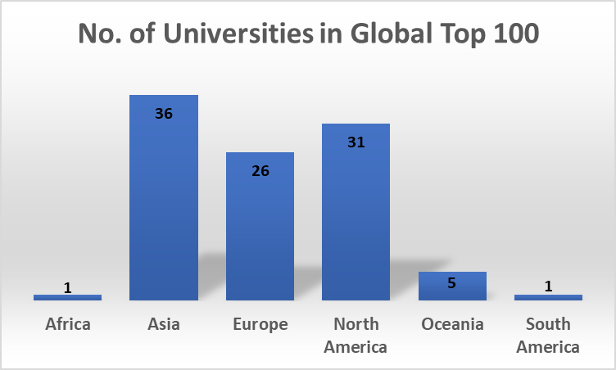
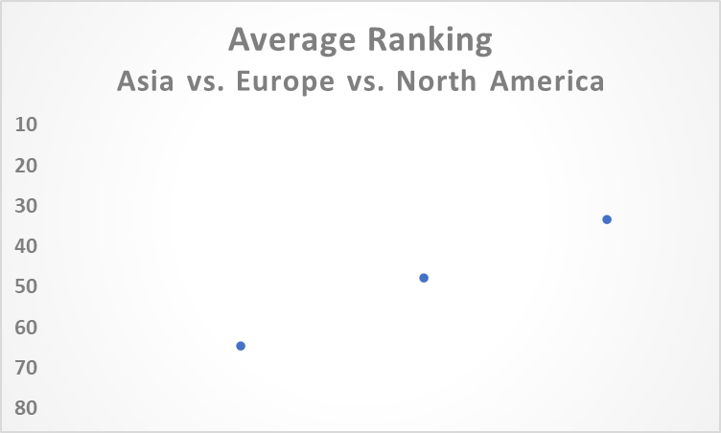
Emerging Challengers: Regions
Global Top 100 Innovative Universities
North
America
Europe
Asia
Asia has the highest number in the Top 100 list, followed by North America and Europe.
North America occupies the highest average ranking, followed by Europe and Asia.

Slide 30
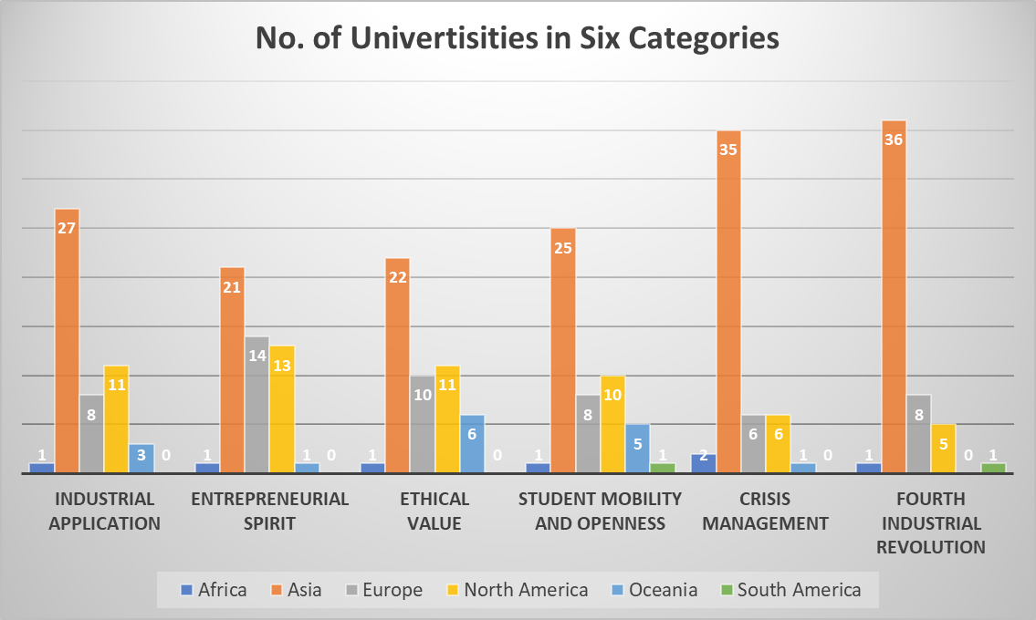
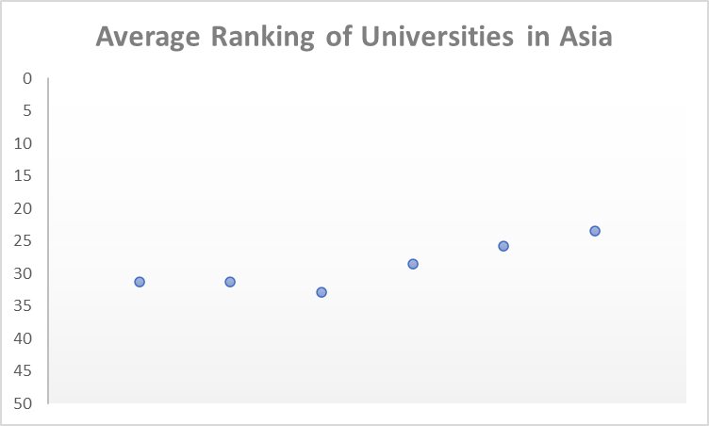
Emerging Challengers: Regions
Top 50 in Six Categories
CM
FI
IA
ES
SO
EV
IA: Industrial Application; ES: Entrepreneurial Spirit; EV: Ethical Value;
SO: Student Mobility & Openness; CM: Crisis Management; FI: Fourth Industrial Revolution
The average ranking of Asian universities increased in three categories, Student Mobility & Openness, Crisis Management, and Fourth Industrial Revolution.
Although Asian universities have relatively lower rankings, they have highest number in all six categories, compared to Europe and North America.

Slide 31
Table of Contents
The New Ranking: Importance and Methodology
The Rankings of Innovative Universities
Cases and Implications
☞
Conclusion

Slide 32
Conclusion
The New Normal
The Pandemic
The 4th Industrial Revolution
New Challenges
Need to redefine the value of higher education
Need to be agile in cross-learning and innovation
Questions and comments (top100@wuri.world)

